Slide 1
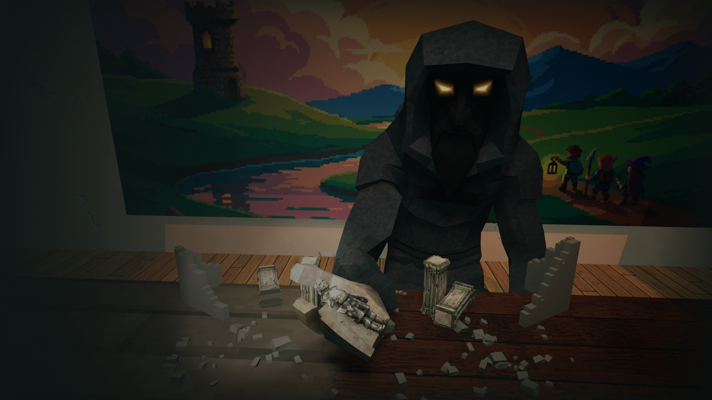

PUBLISHER PITCH
A first-person dungeon crawler, played at the Dungeon Master's table.
[studio name] · [date]
Notes:
Key art and one line, then straight to the key information.

Slide 2



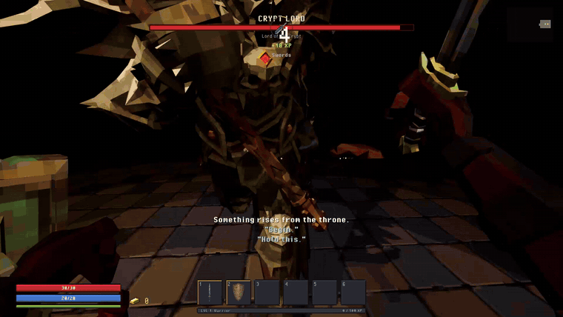
THE GAME AT A GLANCE
GENRE
First-person roguelike dungeon crawler
COMBAT
Melee: swords, maces, shields, spells
PLAYERS
Solo, online co-op in development
ENGINE
Unity 6
PLATFORMS
PC first, open to more
STATUS
Playable demo, intro to first boss
RELEASE
[window]
You sit at a stranger's table. He builds a dungeon in front of you, talks to you while you play it, and at the end he fights you himself.
PRICE
[price]
THE ASK
[$ total, months]
THE TABLE WAITS
02
Notes:
The facts first. The GIF is raw demo gameplay. Platforms stay open on purpose: publishers want a say.

Slide 3


WHO WE ARE
WHY THIS GAME
photo
[Name]
[the personal reason, in two sentences]
[role]
[shipped games, background, skills]
6 MONTHS
photo
[Name]
[role]
From first commit to a playable demo, with its own art pipeline, generated dungeons and a boss fight.
[shipped games, background, skills]
THE TABLE WAITS
03
Notes:
Who is making it, and why. Shipped work counts even if it did not sell; if there is none, the demo is the proof.

Slide 4
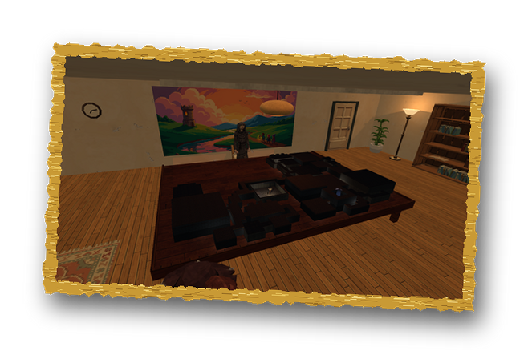
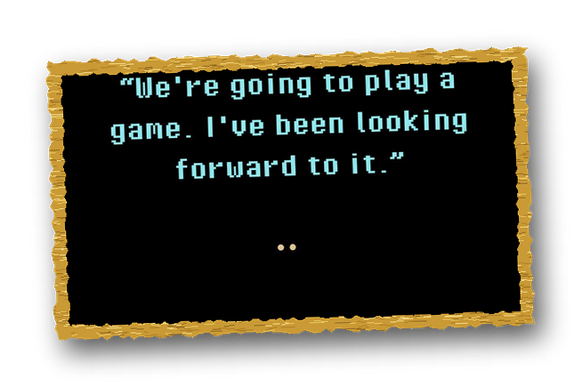
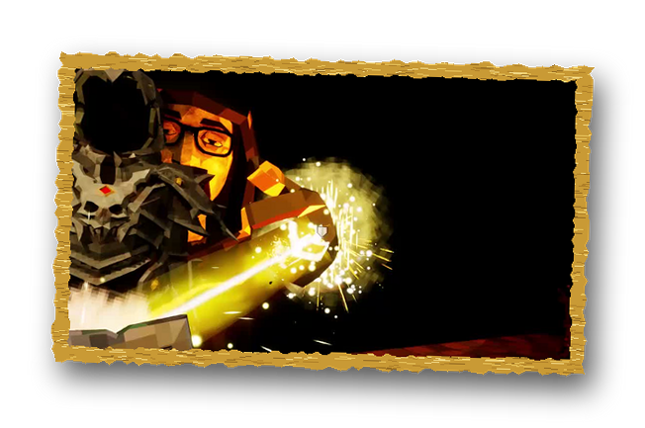
WHY THIS GAME, WHY NOW
01
02
03
A STEADY GENRE
A HOST, NOT A MENU
MADE TO BE SHARED
First-person dungeon crawlers and roguelikes keep selling on PC.
[genre sales figure]
In most dungeon crawlers nobody runs the game. Here the Dungeon Master talks, reacts and fights you.
A DM who talks back and a boss fight in front of him are moments people clip and post.
[000]
[000]
[000]
STEAM WISHLISTS
SHORT-VIDEO VIEWS
PLAYTESTERS
THE TABLE WAITS
04
Notes:
The business why: the gap this game fills. Back each point with a number; the bottom row is traction.

Slide 5
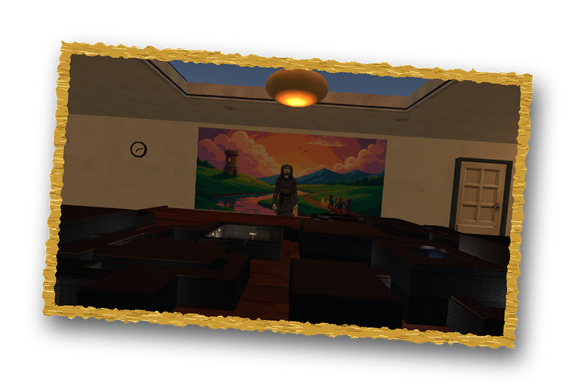
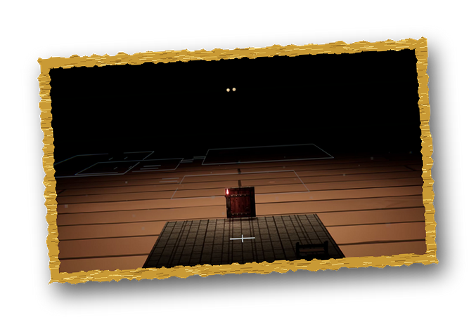
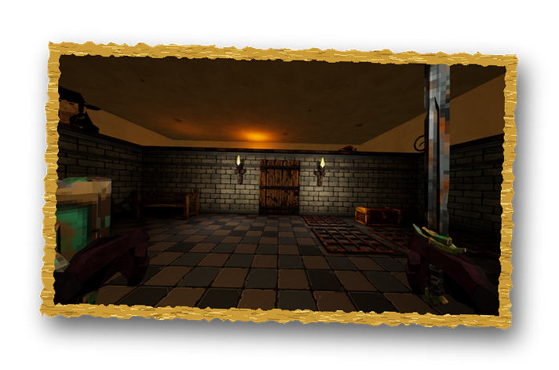
EVERY NIGHT, HE PLAYS A GAME WITH YOU
THE ROOM
Between runs you are in a quiet apartment. A stranger waits at a big table.
Sit down and he builds a dungeon on the table, sets down your figure, and you play it in first person.
Die, and you are back at the table. Reach the last floor, and he fights you himself.
[The story, in two sentences.]
THE TABLE
THE DUNGEON
THE TABLE WAITS
05
Notes:
The finished vision, familiar parts first, then the twist. The story line is open until the narrative is chosen.

Slide 6
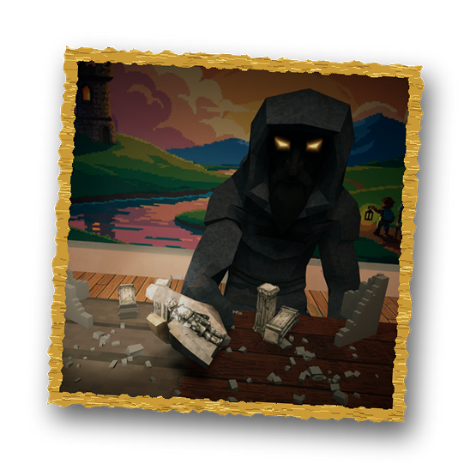
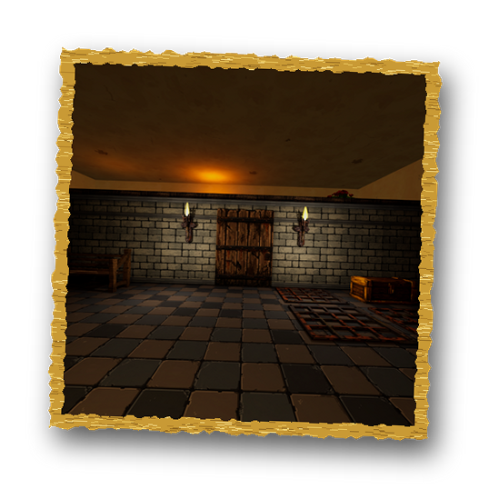
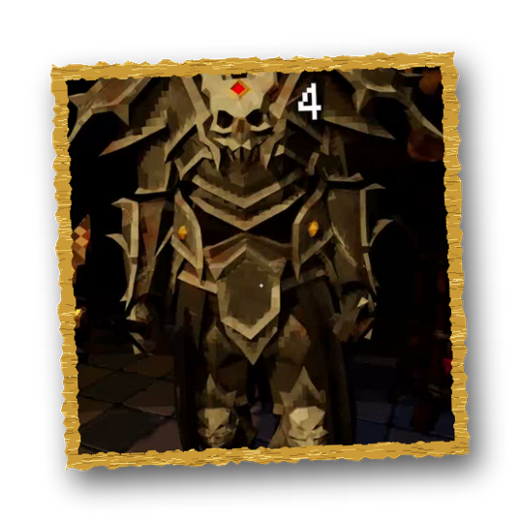

WHAT YOU DO IN IT
THE DM IS IN THE ROOM
A NEW DUNGEON EACH RUN
He builds every floor, comments on how you play, and leans in for the final fight.
MELEE THAT HITS
Hand-built rooms, generated floors, ambushes and traps.
HIS FINAL FIGHT
Swings, blocks, a shield bash and spells. Kills fly.
A stage at the edge of the table. Block his beam, or burn.
THE TABLE WAITS
06
Notes:
What makes it play differently. Each feature has the footage that proves it.

Slide 7

TWO LOOPS
WAKE UP
1
EVERY FLOOR
Explore, fight, loot, gear up, go down. Skills grow with use; gear gets better every floor.
1
WIN OR DIE
5
2
SIT DOWN
EVERY NIGHT
5
2
EVERY FLOOR
Wake up in the room, sit at his table, pick a figure and descend. Win, and a new morning comes. Die, and the figure joins the memorials.
4
3
The next night, the table waits again.
DESCEND
4
3
PICK A FIGURE
THE TABLE WAITS
07
Notes:
The inner ring is every floor, minute to minute; the outer ring is a night, one run.

Slide 8
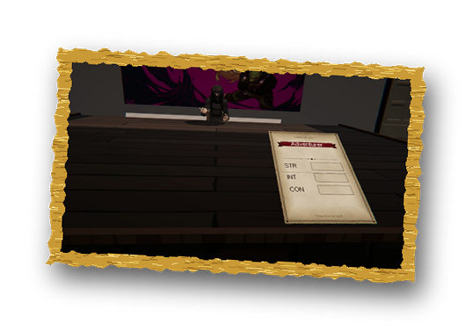
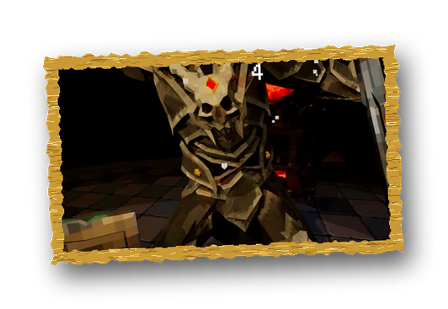
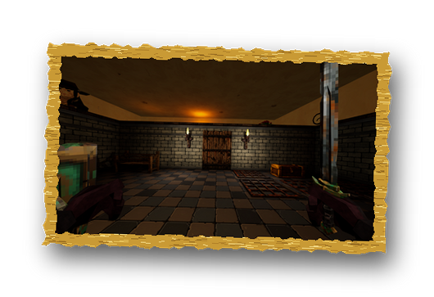
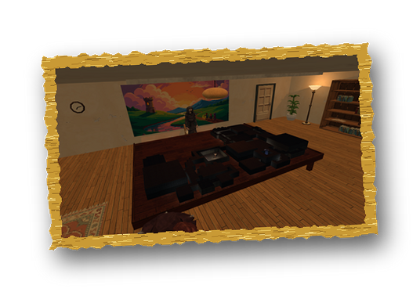
ALREADY BUILT
22
10
50+
4
1
HAND-BUILT ROOMS
ENEMY TYPES
ITEMS
CLASSES
BOSS STAGE
HE DEALS THE CHARACTER SHEET
BOSSES WITH WEIGHT
ROOMS BUILT BY HAND
ONE PAINTED LOOK
THE TABLE WAITS
08
Notes:
Nothing here is a promise: each number and picture is from the demo.

Slide 9

WHAT GAMES LIKE OURS EARNED
GAME
YEAR
PRICE
REVIEWS
EST. REVENUE
WEAKER THAN US
[title]
[fill in]
[fill in]
[fill in]
[fill in]
about 70% of our budget
COMPETITIVE
[title]
[fill in]
[fill in]
[fill in]
[fill in]
about 130% of our budget
WITHIN REACH
[title]
[fill in]
[fill in]
[fill in]
[fill in]
about 300% of our budget
Method Released in the last 3 years, same subgenre and price band, similar team size. Estimated revenue = Steam reviews x 30 x price.
THE TABLE WAITS
09
Notes:
Three comparable games: recent, same subgenre and price, similar team size, never the genre's biggest hits. Pick by estimated revenue against the budget: about 70% (weaker than us), 130% (competitive), 300% (within reach). Estimate revenue as Steam reviews x 30 x price.

Slide 10



FROM DEMO TO RELEASE
PROTOTYPE
PRODUCTION
CONTENT COMPLETE
DONE
[date]
[date]
FEATURE COMPLETE
[date]
VERTICAL SLICE
RELEASE
Oct 2026
[date]
RISK 1: CONTENT VOLUME
RISK 2: COMBAT FEEL
RISK 3: TEAM CAPACITY
2 of 6 planned biomes are built. New ones reuse the room kit, the generator and the painting pipeline.
Tuned with scripted combat tests. Next: [external playtests]
[what the team lacks, and who covers it]
THE TABLE WAITS
10
Notes:
Milestones from now to release, about 30% margin on each; content complete to release is usually about three months. Be open about the risks.

Slide 11


WHAT WE NEED
INVESTMENT
[$000,000]
WHERE IT GOES
Programming and design
[$]
Art and animation
[$]
= [$ a month] x [months] to a finished PC build
Audio and music
[$]
Break-even ask / (70% x price) = [copies]
QA and playtesting
[$]
ALSO LOOKING FOR
Marketing and PR
Porting
About 30% margin is built into each line. Marketing, ports and localisation are on the partner's side.
QA and localisation
Platform support
THE TABLE WAITS
11
Notes:
One exact number: monthly burn x months to a finished PC build, with about 30% margin built into each line. Too low ends the pitch; too high leaves room to talk. Break-even is the ask divided by 70% of the price.

Slide 12
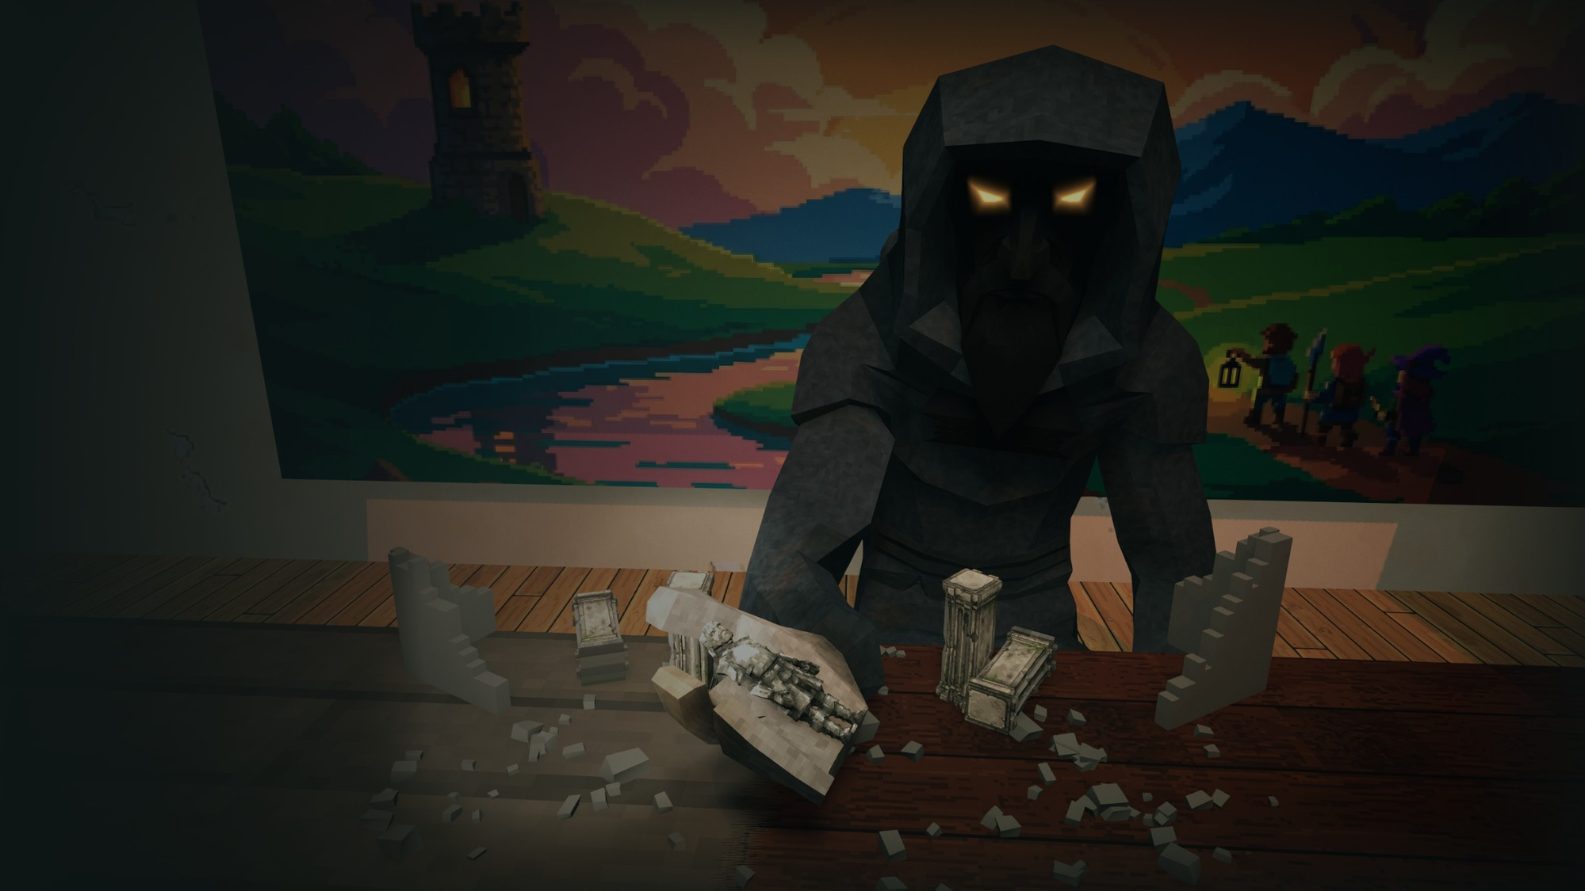

THE ASK
[$ total, months]
GENRE
First-person roguelike dungeon crawler
RELEASE
[window]
PLATFORMS
PC first, open to more
ENGINE
Unity 6
BUILD
[link]
STEAM PAGE
[link]
CONTACT
[email]
Skip intro on the main menu goes straight to play.
Notes:
The summary to leave up during questions. Send the playable build with it.

